Slide 1




Sonam Okuda, Jade Lombardo
Disney Movie Analytics and Prediction

Slide 2

Purpose
Use machine learning to visualize and predict the trends of Disney movies released in the past 20 years.

Slide 3


Finding the Dataset

Slide 4

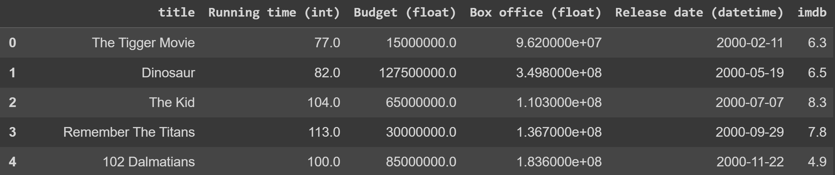
Dataset Columns
Box Office
Run Time
Title
IMDB Rating
Release Date
Budget

Slide 5


Data Exploration

Slide 6





New Columns
-
=
Box Office
Budget
Total Profit

Slide 7

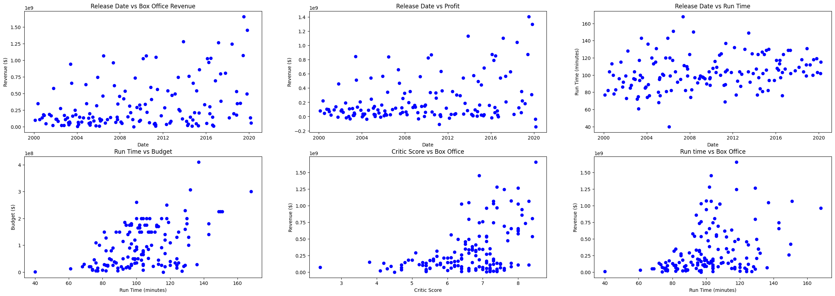
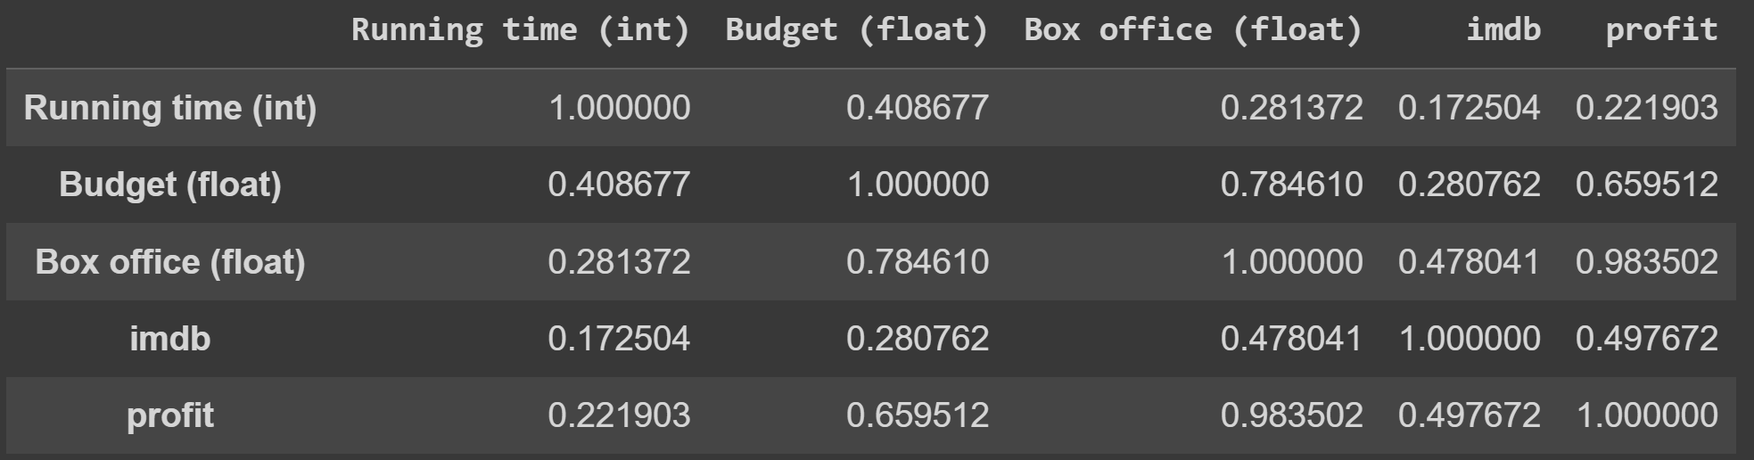
Initial Plots

Slide 8

Regression
Modeling

Slide 9




Predictions
IMDB
BUDGET
BOX OFFICE

Slide 10

Model Analysis
Multiple Linear Regression
Ridge and Lasso Regression
Polynomial Regression
0.36
0.36
0.16
RSE
RSE
RSE

Slide 11


43%
Ranking
1
2
2
Polynomial Regression
Ridge and Lasso Regression
Multiple Linear Regression

Slide 12
Classification Model

Slide 13
600%
S
400%
Flop or Banger
A
250%
B
100%
C
F
<100%

Slide 14
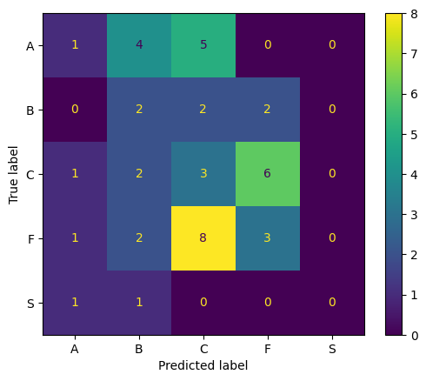

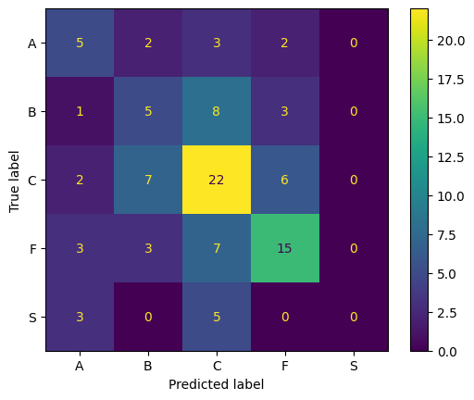

KNN
Classification

Slide 15
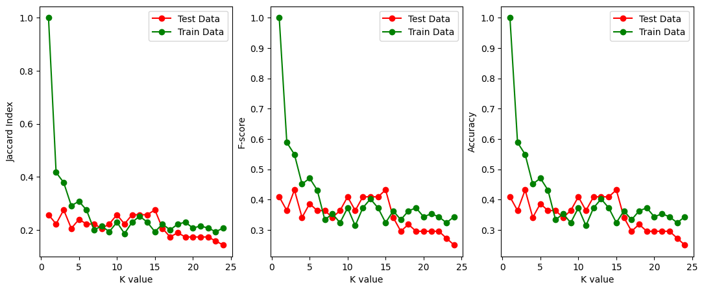
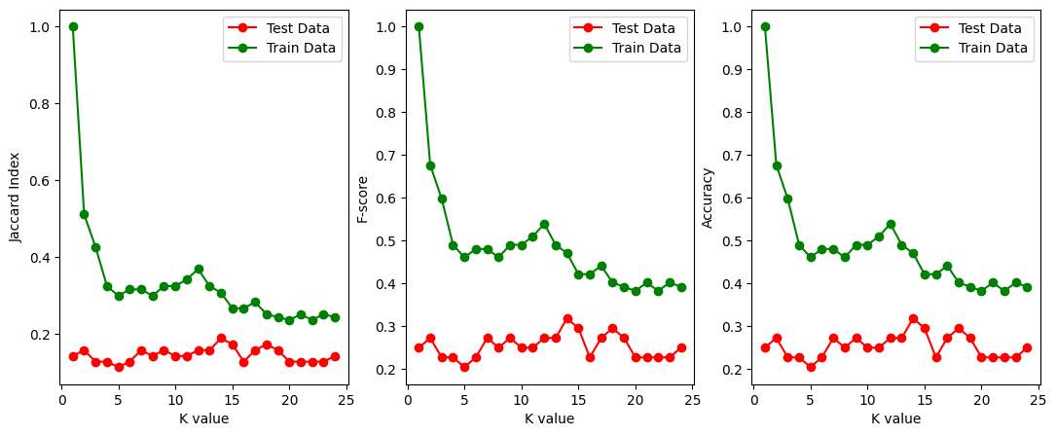
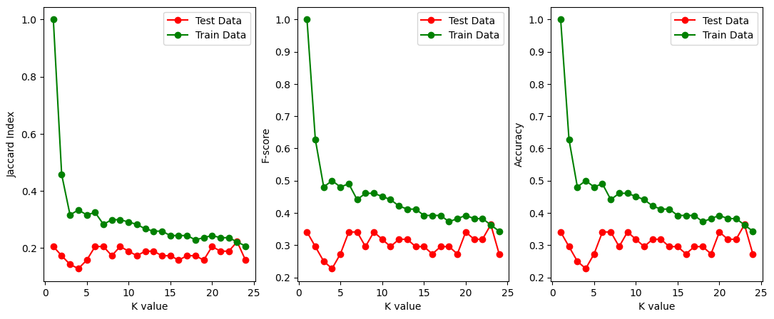

Slide 16

KNN Model Analysis
Jaccard
F-Score
Accuracy
0.299
0.46
0.46

Slide 17






0.16
0.36
Multiple Linear Regression
Polynomial Regression
0.45
KNN

Slide 18

Thank you!

